Slide 1
Tool Layout

Slide 2
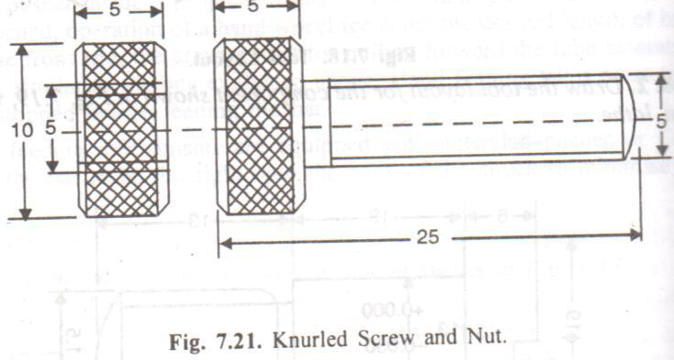
Example 1

Slide 3
Operations:
Feed the bar stock to stop.
Turn dia. 5 mm and form the end, box tool with turning and form ending
Cut threads , die head
Knurl, knurl tool
Chamfer 4nos at dia. 10 mm, chamfer tools -front cross slide
Part off screw, parting off tool – rear cross slide
Drill and face the nut, drill and facing tool – turret
Tap the nut, tap – turret
Part off the nut, parting off tool – rear cross slide

Slide 4
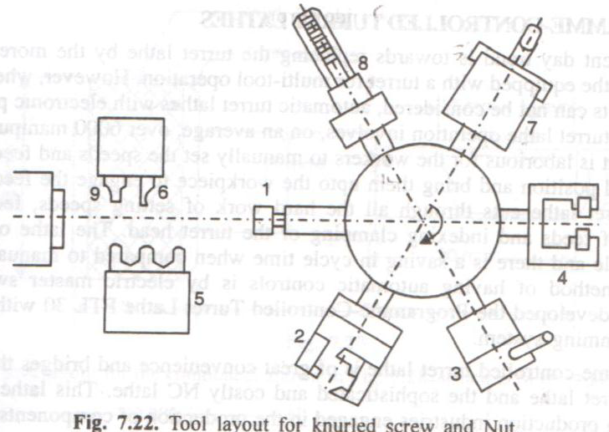

Slide 5
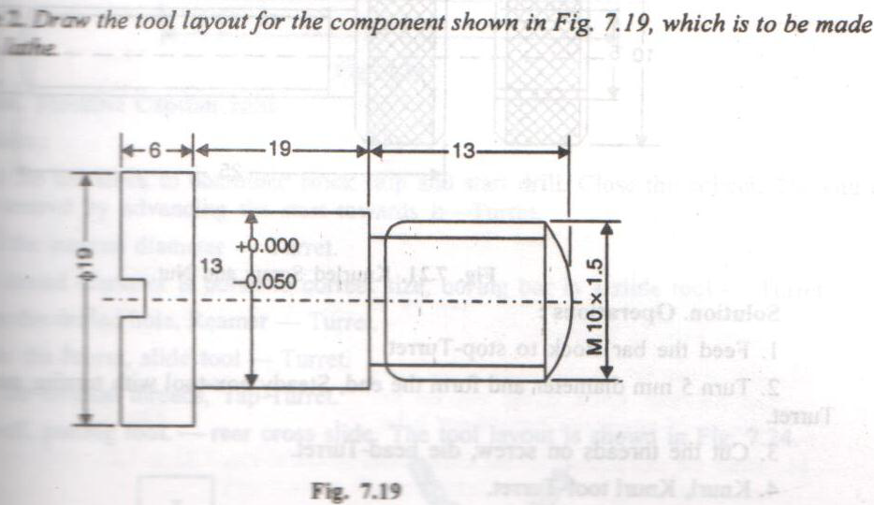
Example 2

Slide 6
Operations:
Feed the bar stock to stop.
Turn dia. 13/12.95 with roller box tool.
Turn dia. 10 with roller box tool.
Form end with roller steady ending tool.
Undercut and chamfer – cross slide
Threading with self opening die head.
Part off with parting off tool in rear tool post.

Slide 7
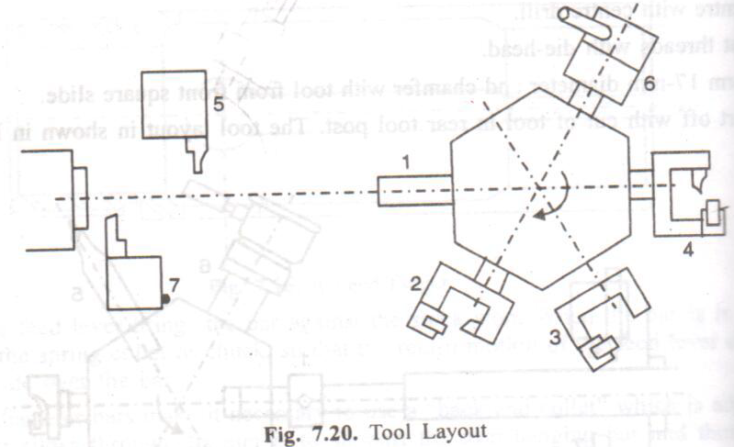

Slide 8
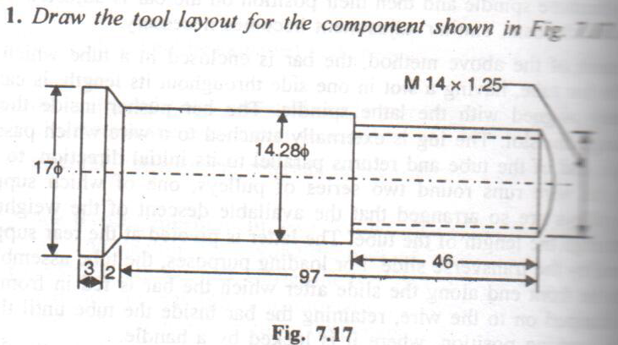
Example 3

Slide 9
Material : dia. 18 mm steel bar machine : capstan lathe
Operations:
Feed the bar stock to stop.
Turn dia. 14 mm with box tool.
Turn dia. 14.28 with box tool.
Form end with roller steady ending tool.
Centre with centre drill
Cut threads with die-head.
Form dia. 17 mm and chamfer with tool from front square slide.
Part off with parting off tool in rear tool post.

Slide 10
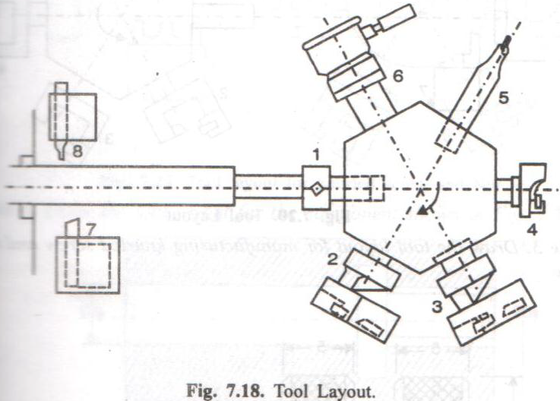

Slide 11
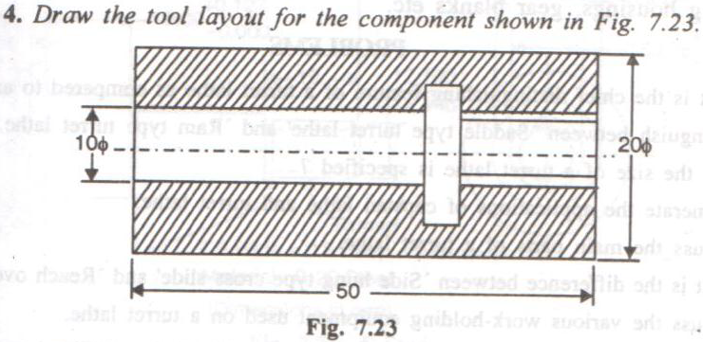
Example 4

Slide 12
Operations:
Feed the bar stock to combined stock stop and start drill. Close the collet. The end of the bar is then centered by advancing the start towards it – turret position 1
Drill the internal diameter - turret position 2
Bore thread dia. to correct size, boring bar in a slide tool holder- turret position 3
Ream the drilled hole, reamer - turret position 4
Make the recess, slide tool turret position 5
Cut the internal threads, tap - turret position 6
Part off with parting off tool in rear tool post.

Slide 13
